Slide 1


What Is Babel In React JS ?
PRESENTER: MOHAMMAD ADIL

Slide 2

WHAT IS ES5 & ES6 ? HISTORY OF JAVASCRIPT
PRESENTER: MOHAMMAD ADIL

Slide 3
History Of JavaScript, ES5 & ES6
JavaScript was invented by Brendan Eich in 1995 in Netscape.
The history is, Brendan Eich created Mocha which became LiveScript, and later JavaScript.
Netscape presented JavaScript to ECMA International, which develops standards and it was renamed to ECMAScript.

Slide 4
ECMA INTERNATIONAL
ECMA stands for “European Computer Manufacturers Association”.

Slide 5
What does ECMA International do?
ECMA International is a non-profit organization that develops standards in computer hardware, communications, and programming languages.
ECMAScript is the official name of the JavaScript language.

Slide 6
History Of JavaScript
1995
1997
1997
JavaScript
ECMA International
ECMAScript
Brendan Eich
ES1
HTML
“W3C”
World Wide Web Consortium

Slide 7
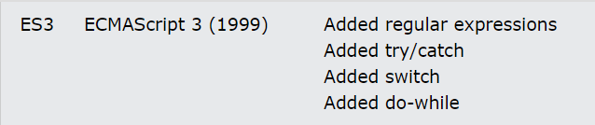
ECMASCRIPT VERSIONS

Slide 8
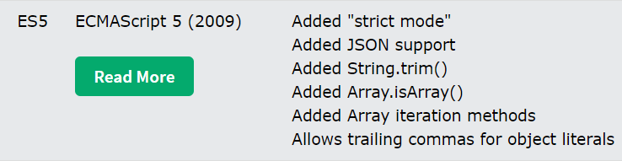
ECMASCRIPT VERSIONS

Slide 9
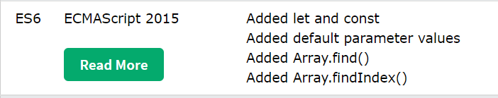
ECMASCRIPT VERSIONS

Slide 10
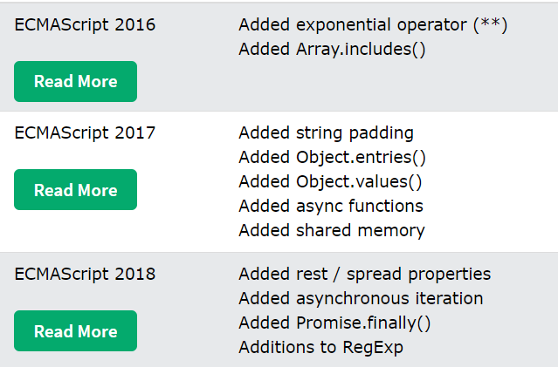
ECMASCRIPT VERSIONS

Slide 11
What Is ECMAScript ?
ECMAScript is a subset of JavaScript.

Slide 12
What Is Babel In React ?
Babel is a JavaScript compiler.
It is mainly used to convert ECMAScript 2015+ code into a backwards compatible version of JavaScript in current and older browsers or environments.
When we create an app by using “create-react-app”, then babel automatically included in our react app.
Babel can convert JSX syntax.

